Slide 1
Prepared by: Muhammad Umer
Intern ID: FLX-S8-342
Data analytics Internship

Slide 2
Agenda
Introduction
Data Exploration
Data Cleaning & Preparation
RFM Analysis Methodology
Customer Segmentation
Data Insights
Recommendations & Conclusion

Slide 3
Introduction
The objective of this analysis is to segment customers using RFM (Recency, Frequency, Monetary) analysis and apply insights to both existing customers and the New Customer List.
This approach enables identification of:
High-value customers
Loyal customers
At-risk customers
The insights support data-driven marketing and customer retention strategies.

Slide 4
Data Exploration
Datasets Used
Customer Demographic
Customer Address
Transactions
New Customer List
Initial exploration focused on:
Customer transaction behaviour
Spending and profit patterns
Demographic characteristics (age, gender, wealth segment)

Slide 5
Data Cleaning & Preparation
To ensure reliable analysis, the following cleaning steps were performed:
Removed records with missing customer IDs.
Excluded transactions with missing dates or amounts.
Removed duplicate transaction records.
Standardised data types for dates and numeric fields.
Validated transaction-customer consistency.
Only clean and valid records were used for RFM analysis.

Slide 6
New Columns Created
Additional derived columns were created to enhance analysis:
Profit: Transaction revenue minus cost.
Gender: Standardised gender values.
Age: Calculated from date of birth.
Age Category: Grouped age bands.
These variables improved customer profiling and segmentation insights.

Slide 7
RFM Analysis Overview
RFM analysis measures customer value using:
Recency: Days since last purchase.
Frequency: Number of transactions.
Monetary: Total transaction value.
This method helps identify customer engagement and profitability.

Slide 8
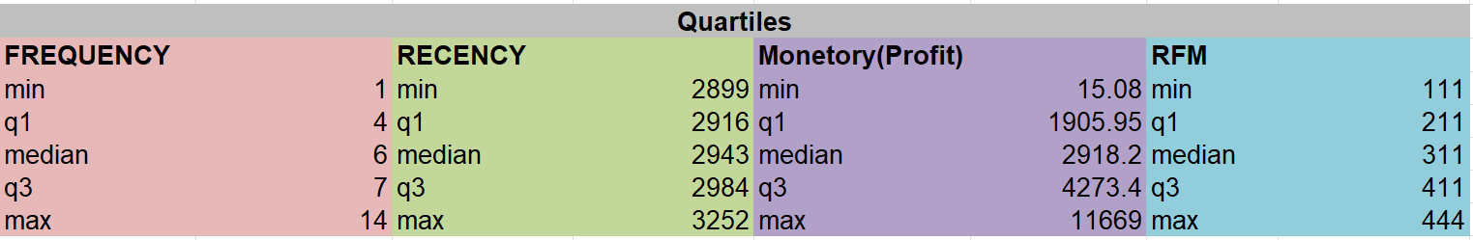
Quartile-Based Scoring
Scoring logic:
Lower recency = higher score
Higher frequency = higher score
Higher monetary value = higher score

Slide 9
Customer Segmentation
Based on RFM scores, customers were segmented into:
Platinum: Highest-value customers
Gold: Loyal and high-potential customers
Silver: Medium-value customers
Bronze: Low-value or at-risk customers

Slide 10
RFM Score Distribution
Chart: Count of Customers in RFM Score
Shows customer distribution across RFM scores
High RFM score customers represent the most valuable segment
Insight:
High RFM score customers should be prioritised for retention strategies.

Slide 11
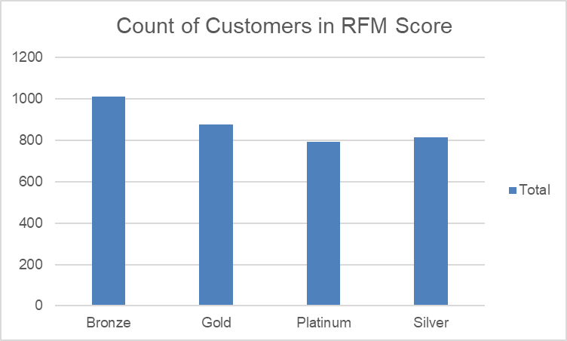
RFM Score Distribution
Chart: Count of Customers in RFM Score
Shows customer distribution across RFM scores
High RFM score customers represent the most valuable segment
Insight:
High RFM score customers should be prioritised for retention strategies.

Slide 12
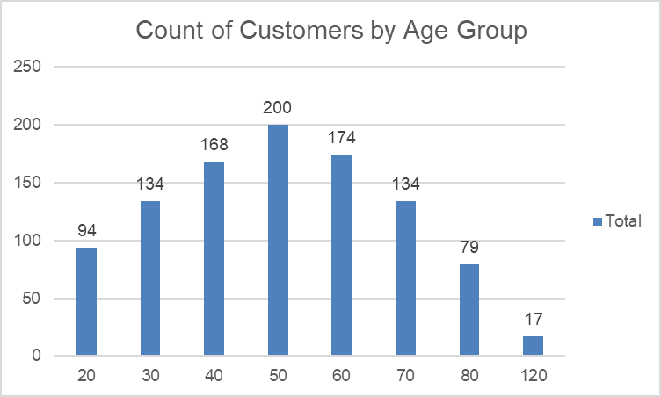
Customers by Age Group
Chart: Count of Customers by Age Group
Displays customer concentration across age categories
Majority of customers fall within working-age groups
Insight:
Certain age groups show higher engagement and spending behaviour.

Slide 13
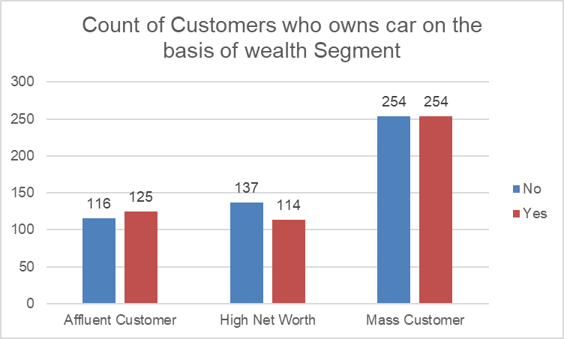
Car Ownership by Wealth Segment
Chart: Count of Customers Who Own a Car by Wealth Segment
Compares car ownership across wealth segments
Affluent and Mass Customer segments show higher ownership
Insight:
High-wealth customers with car ownership present strong upsell potential.

Slide 14
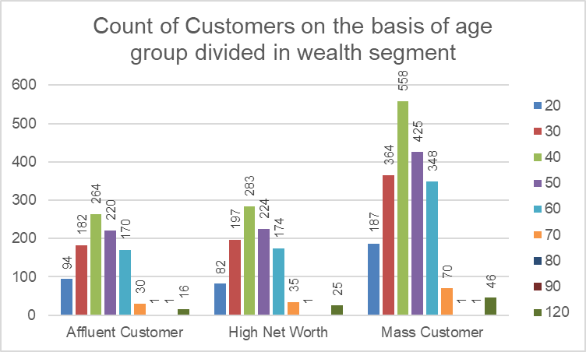
Age Group by Wealth Segment
Chart: Count of Customers by Age Group Divided by Wealth Segment
Highlights interaction between age and wealth
Certain age groups dominate affluent segments
Insight:
Customers in specific age-wealth combinations represent high-value targets.

Slide 15
Key Insights Summary
High RFM customers generate the majority of revenue and profit.
Wealth segment and age strongly influence customer value.
Demographic attributes enhance RFM interpretability.
New customers can be prioritised using demographic alignment.

Slide 16
Business Recommendations
Focus premium offers on Platinum customers
Strengthen loyalty programs for Gold customers
Upsell Silver customers
Apply low-cost re-engagement for Bronze customers
Target new customers matching high-value demographic profiles

Slide 17
Conclusion
Clean data enabled accurate RFM analysis
Quartile-based scoring effectively segmented customers
RFM combined with demographics provides actionable insights
This approach supports data-driven customer engagement and marketing decisions.

Slide 18
Closing Summary
Data was cleaned and analysed using RFM methodology
Customers were segmented into actionable value groups
Insights support targeted marketing and better decision-making
RFM analysis provides a clear, scalable approach to understanding customer value and driving business impact.

